Slide 1
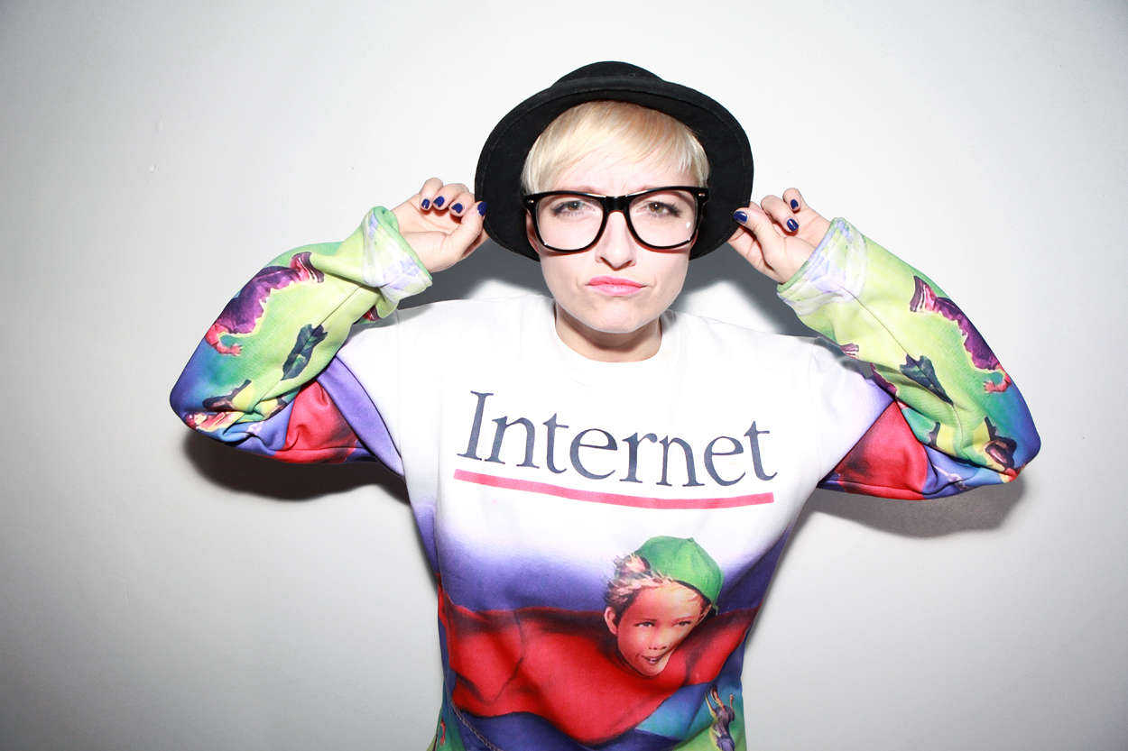

Slide 2
I’m Casie
Stewart and this is my life…
* Not Cassie!

Slide 3
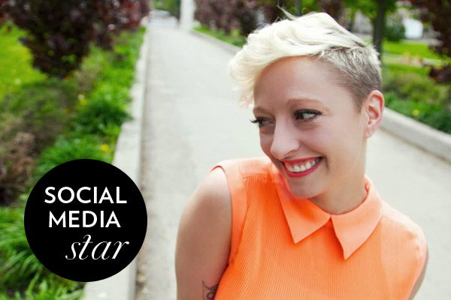
Notes:
I always wanted to be in the spotlight, but never did I ever imagine all this awesomeness would come from starting a blog.I didn’t put that badge there it’s taken right from Fashion Magazine
Fashion Magazine called me a social media star, I’ve been features in the Wall Street Journal, Canadian Business Magazine been on tv, and in movies.

Slide 4
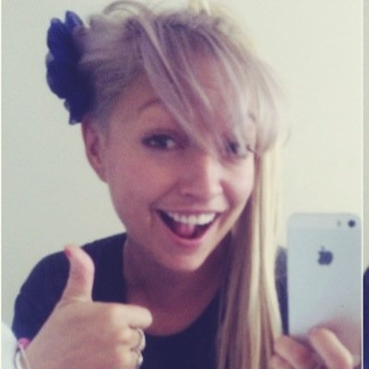
questions, comments, quotes, jokes, love, comments, compliments
Twitter / Instagram:
@casiestewart

Slide 5
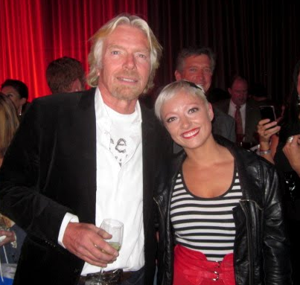


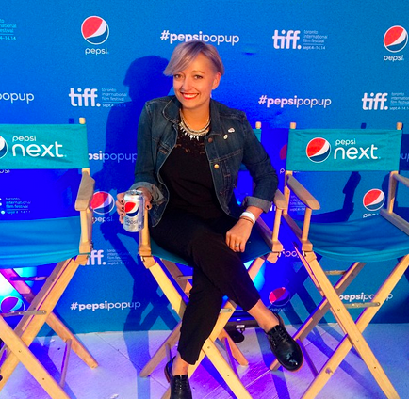
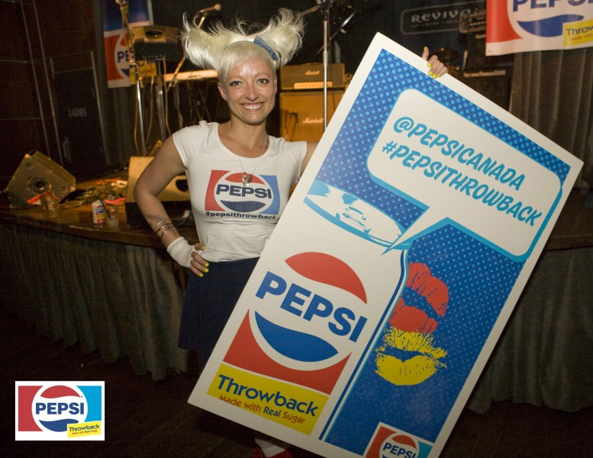

Slide 6

Brand + Shared Experiences
= Memories

Slide 7
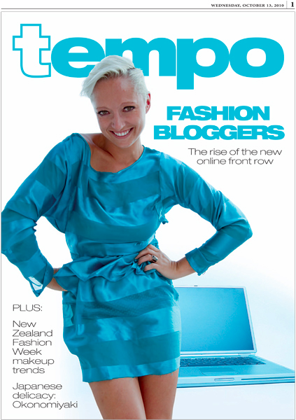

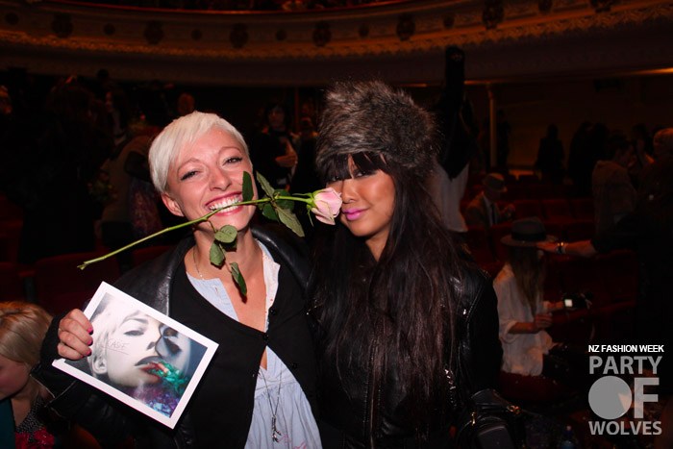

Slide 8
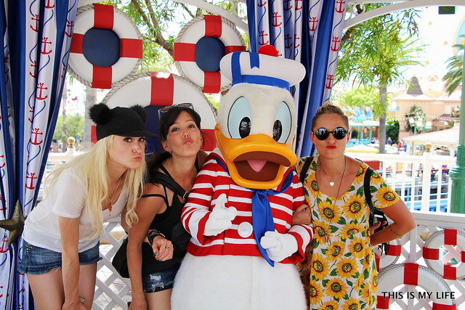

Slide 9
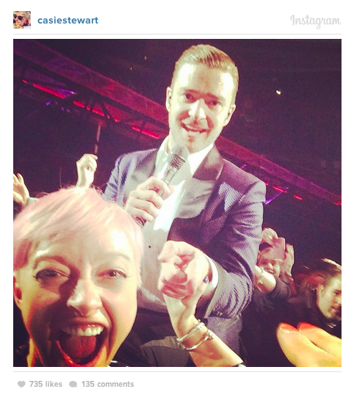
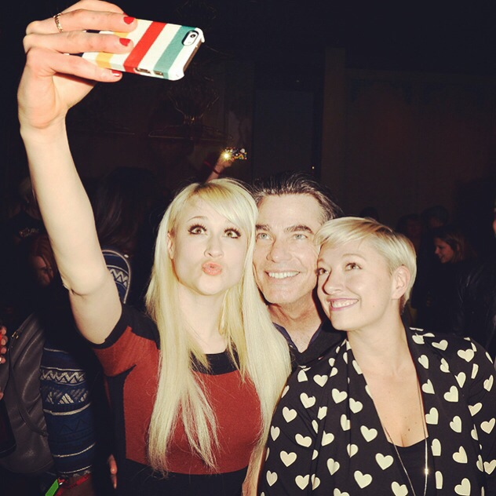

Slide 10
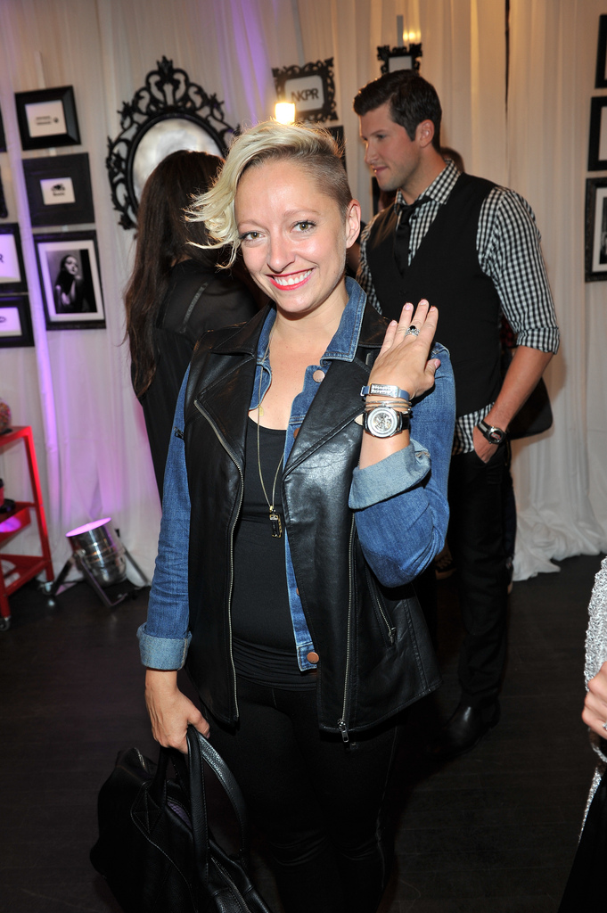

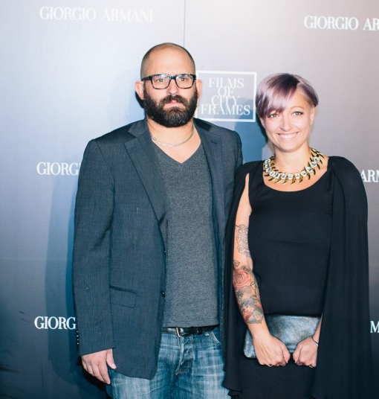
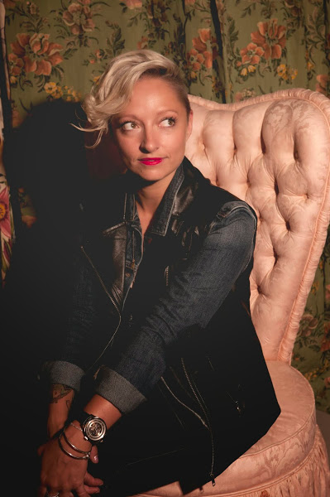

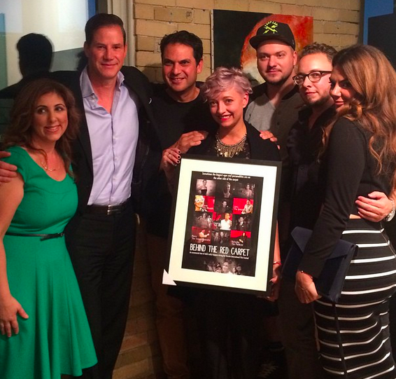
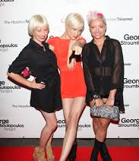
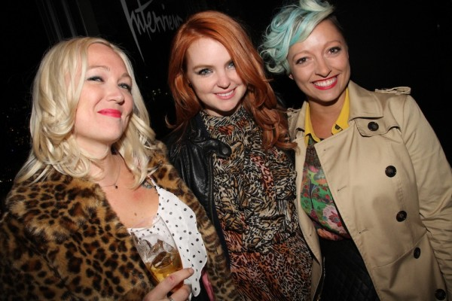

Slide 11
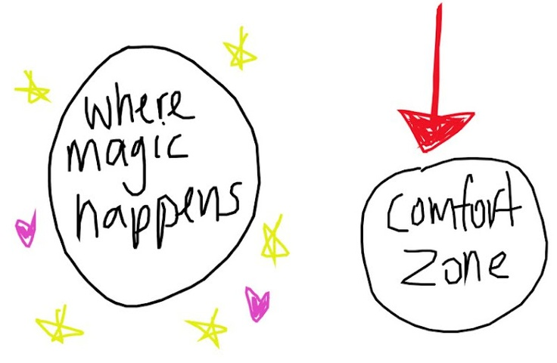

Slide 12
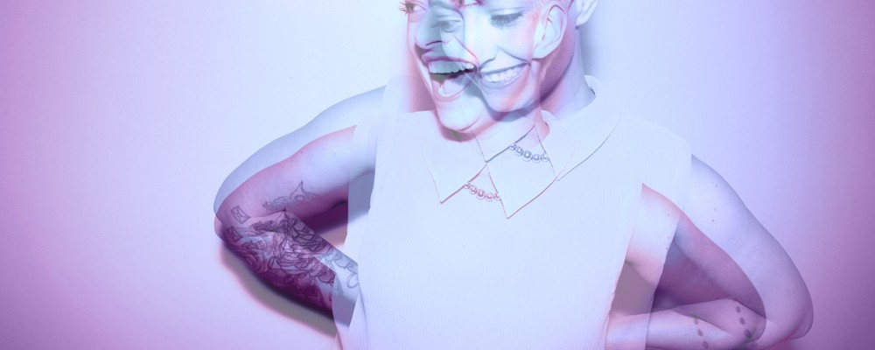
C A S I E S T E W A R T
@casiestewart
casie@casiestewart.com

